Slide 1

RainDrop
Soil moisture monitoring system on LoRaWAN Network

Slide 2
Problem
Resources watering city greenery are used sub-optimally.
It is complicated for the city to monitor work of subcontractors responsible for city plants.
Rapidly changing climate makes watering an important task.

Slide 3
Solution
A system of wireless sensors that measures soil moisture.

Slide 4
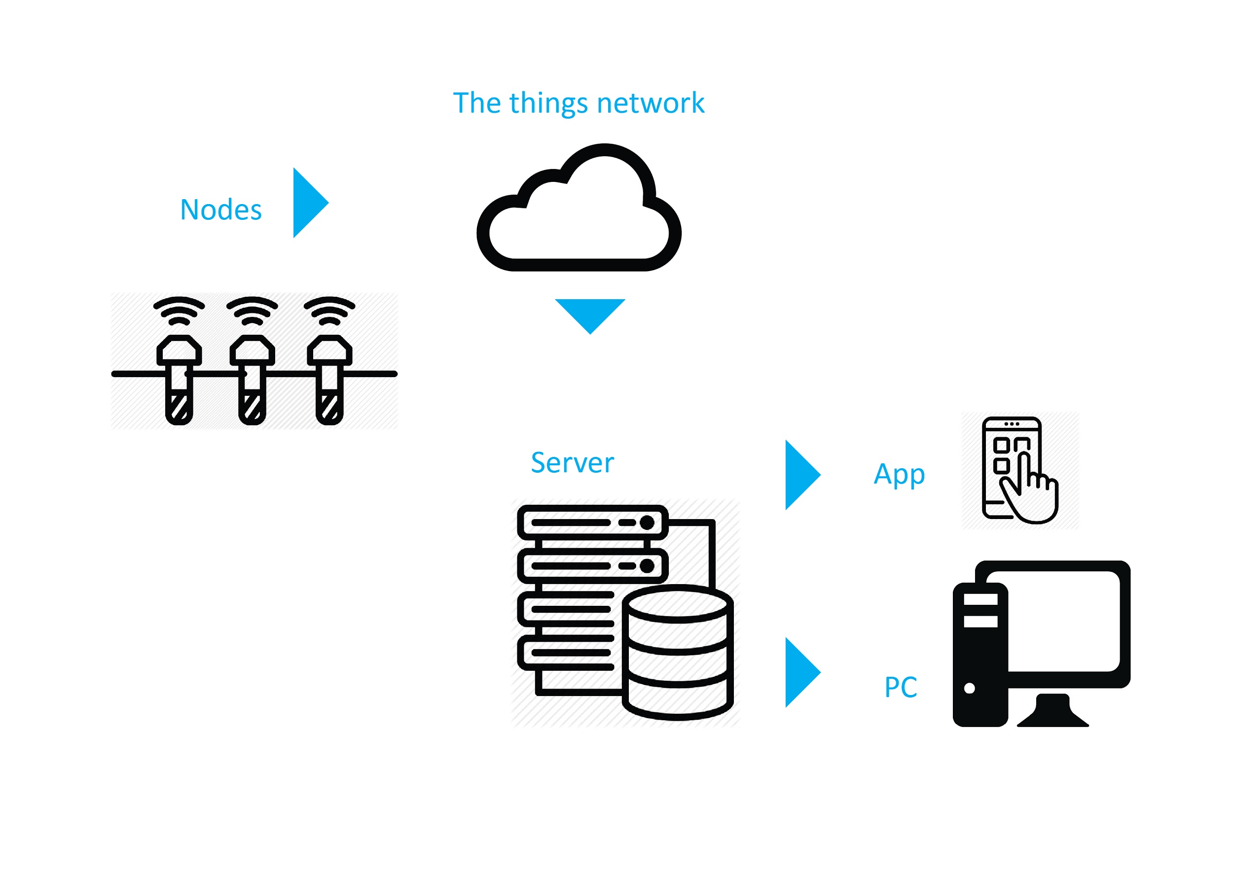

Slide 5
Gains
Municipality gains:
means to evaluate work of subcontractors
Community gains:
means to take care of community-planted trees
Business gains:
means to optimally allocate resources

Slide 6
Results
hardware prototype
backend prototype
cost analysis
enduser application prototype
all work is released under open source licence

Slide 7
Plans
order the first batch of PCBs next week
work on battery life optimization
deploy two LoRa gateways in next month

Slide 8
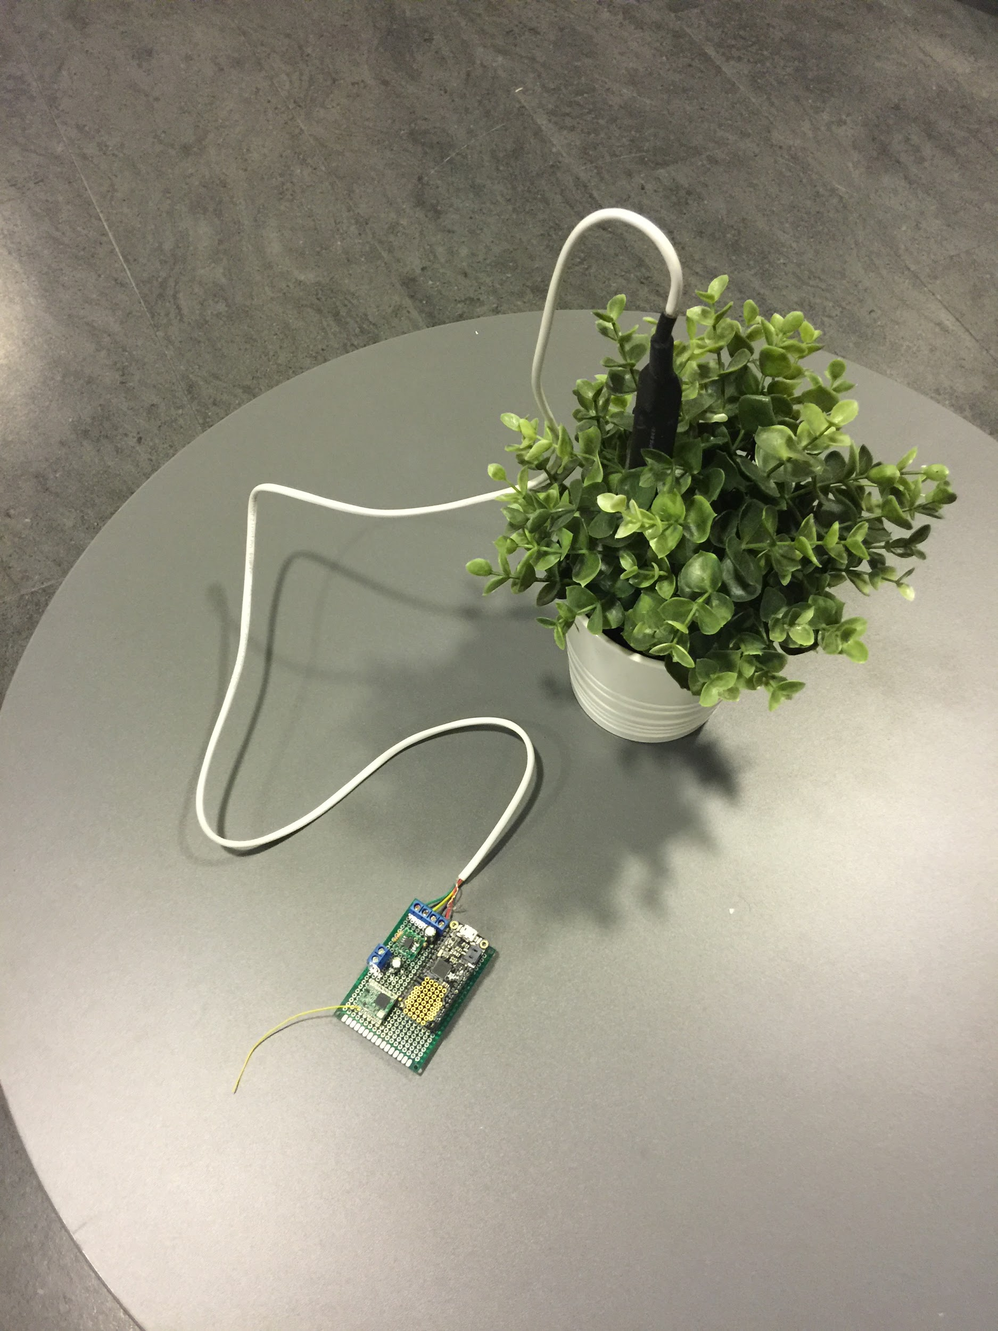
THANK YOU!
Team 11
Albertas Mickėnas
Vaidas Kascėnas
Rūta Gruzdaitė
Vilgailė Narkevičiūtė

Slide 9
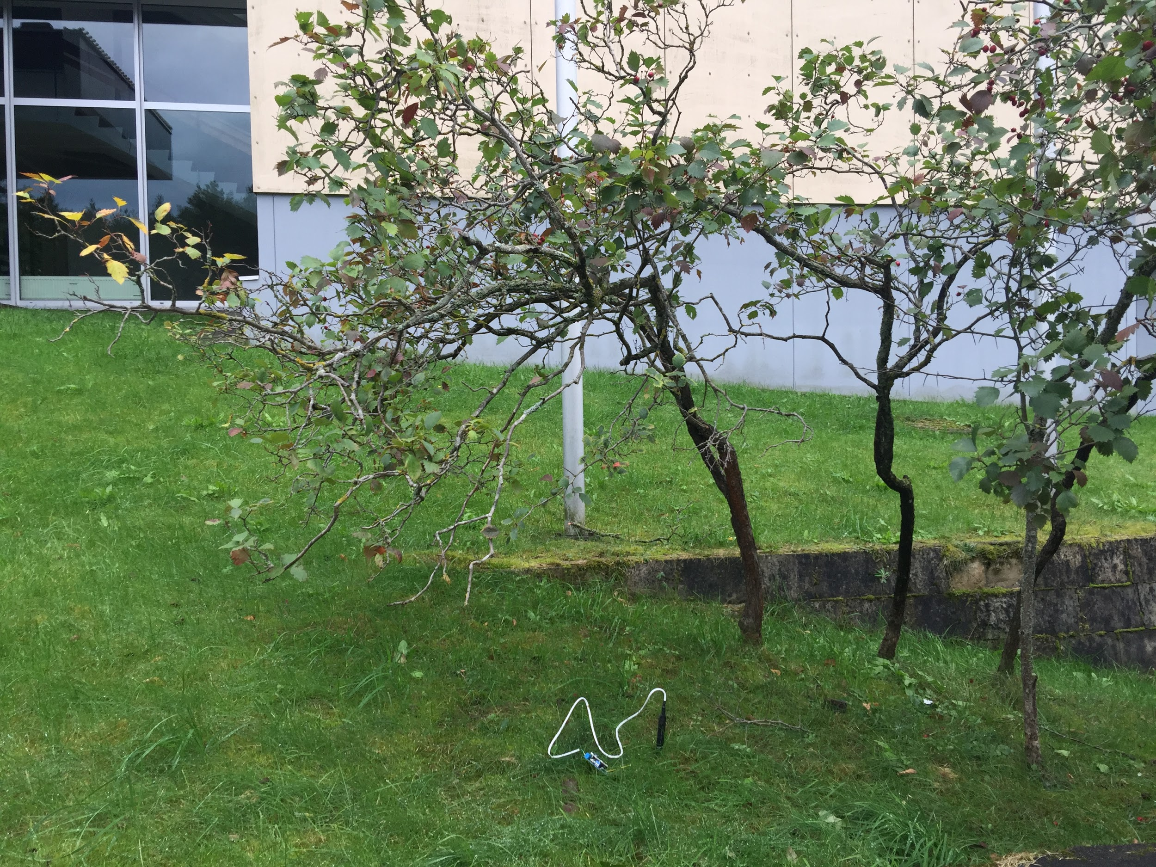
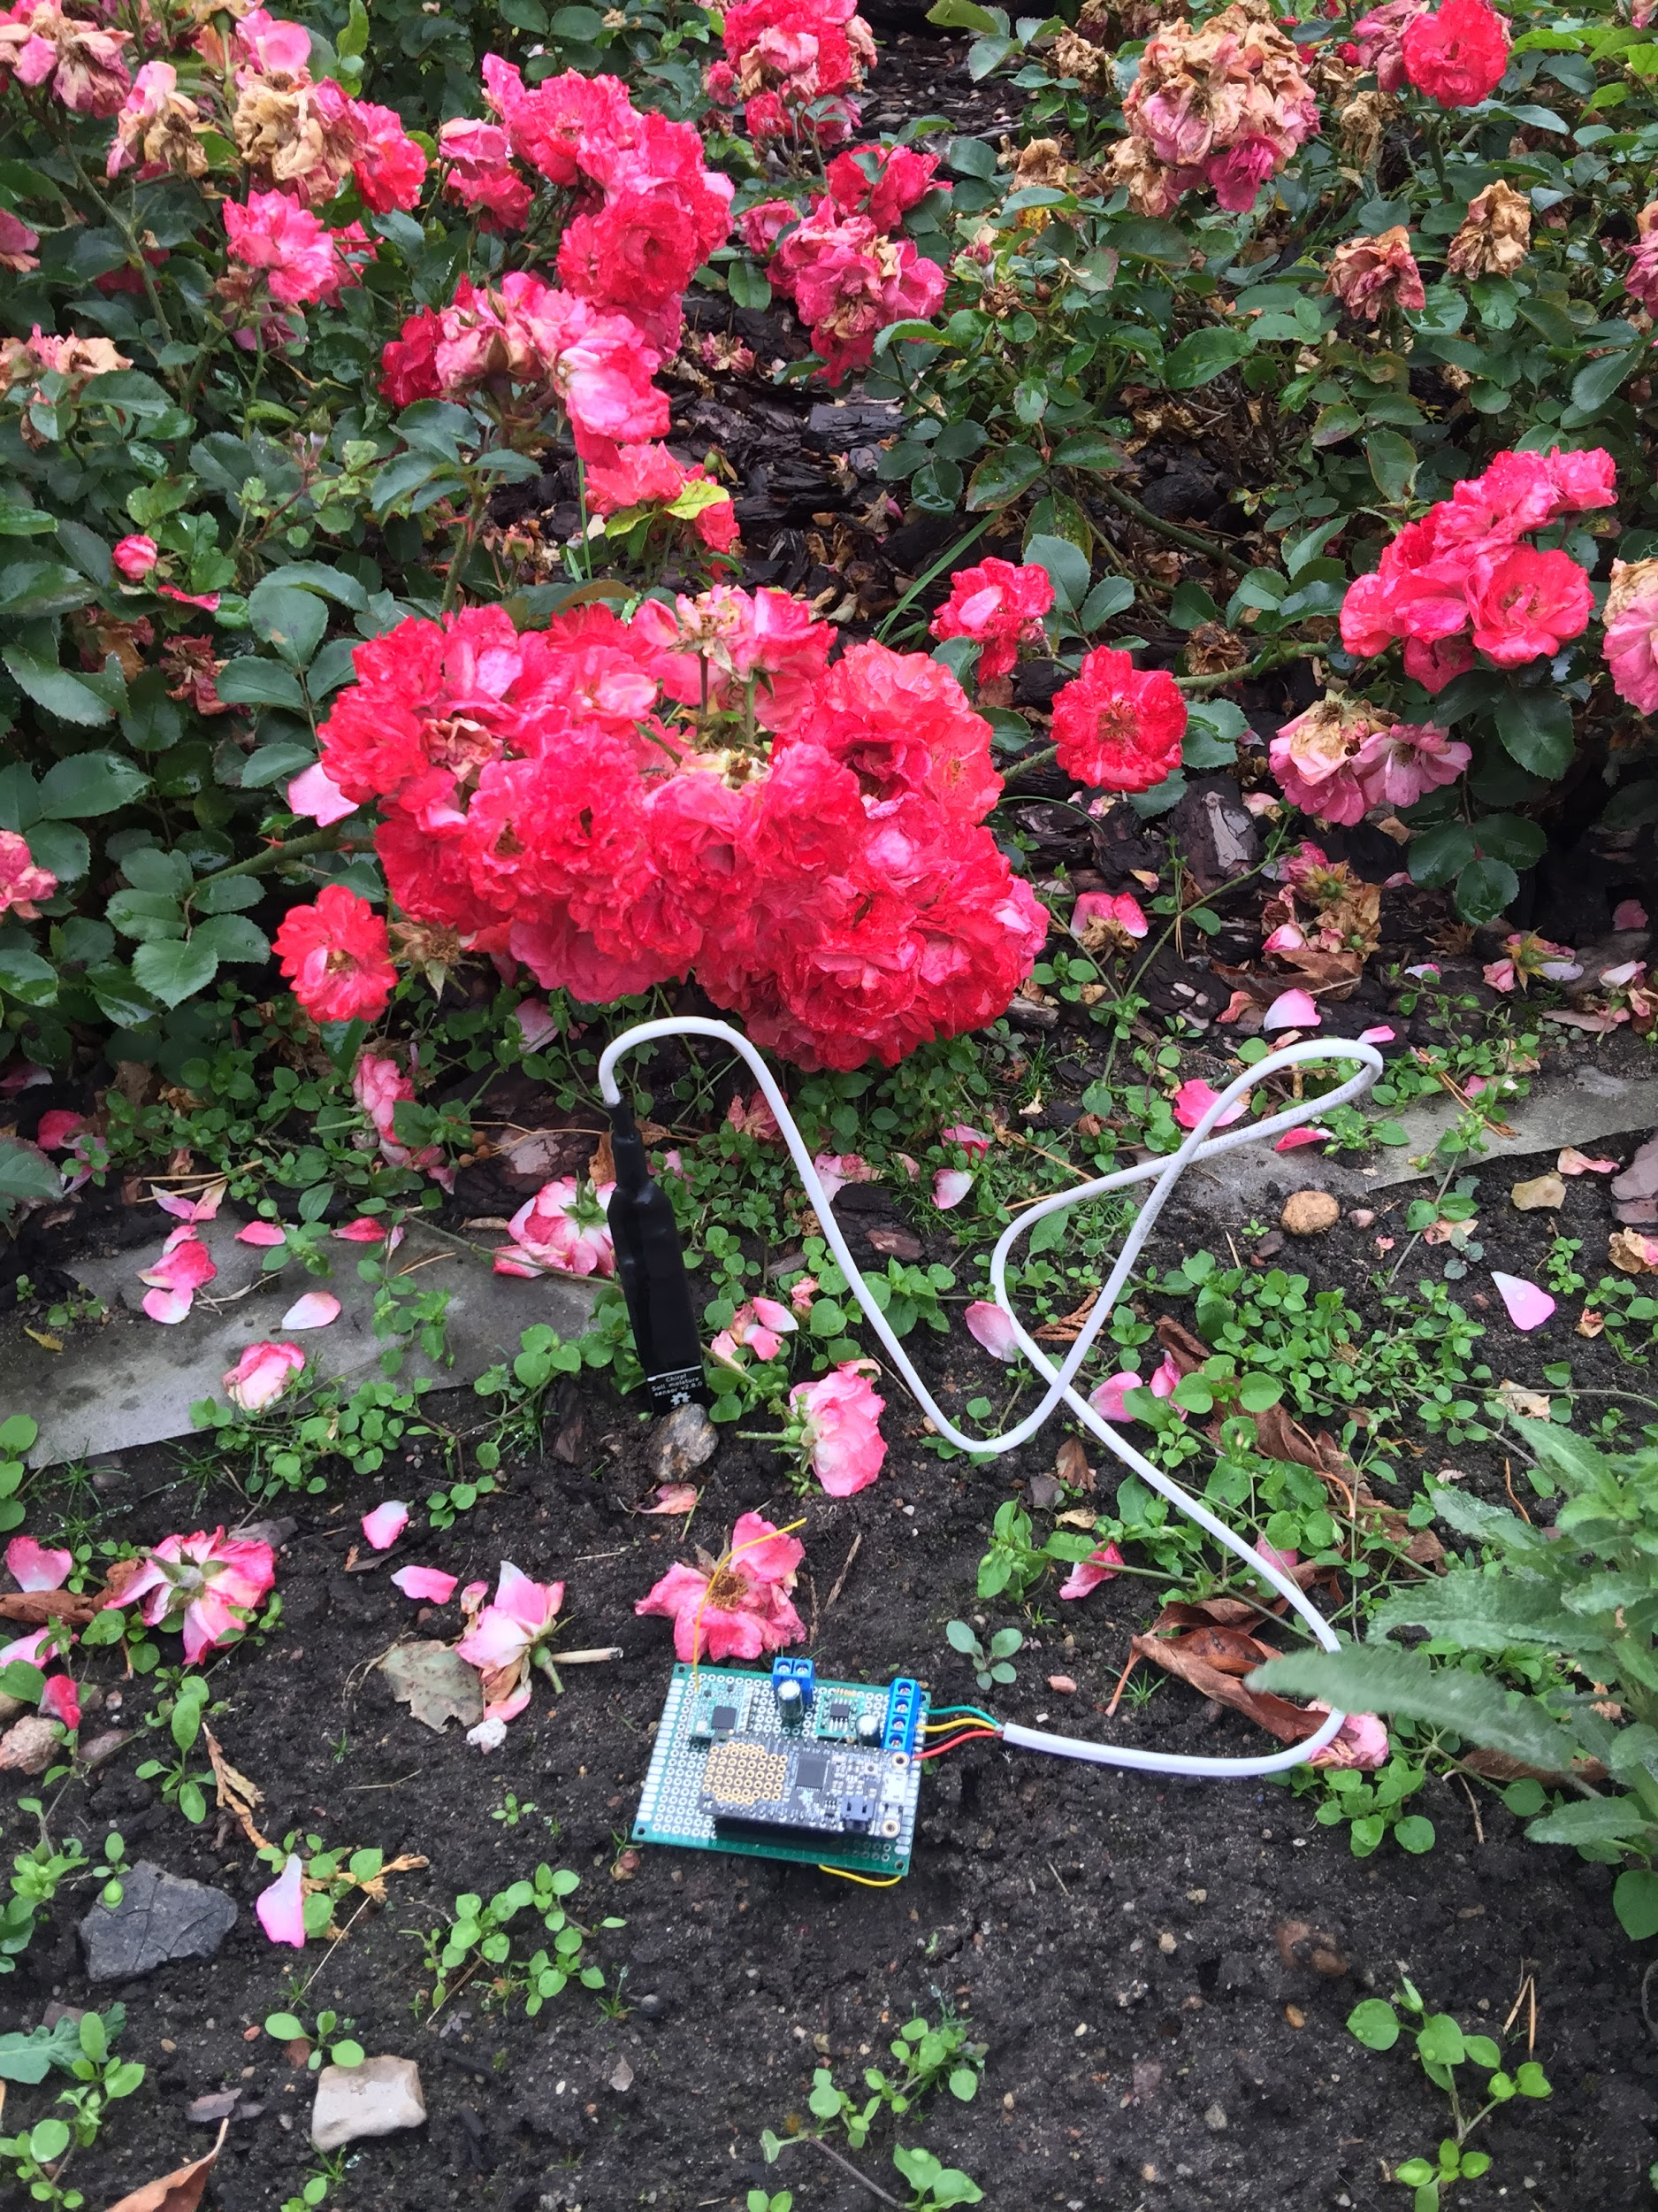

Slide 10
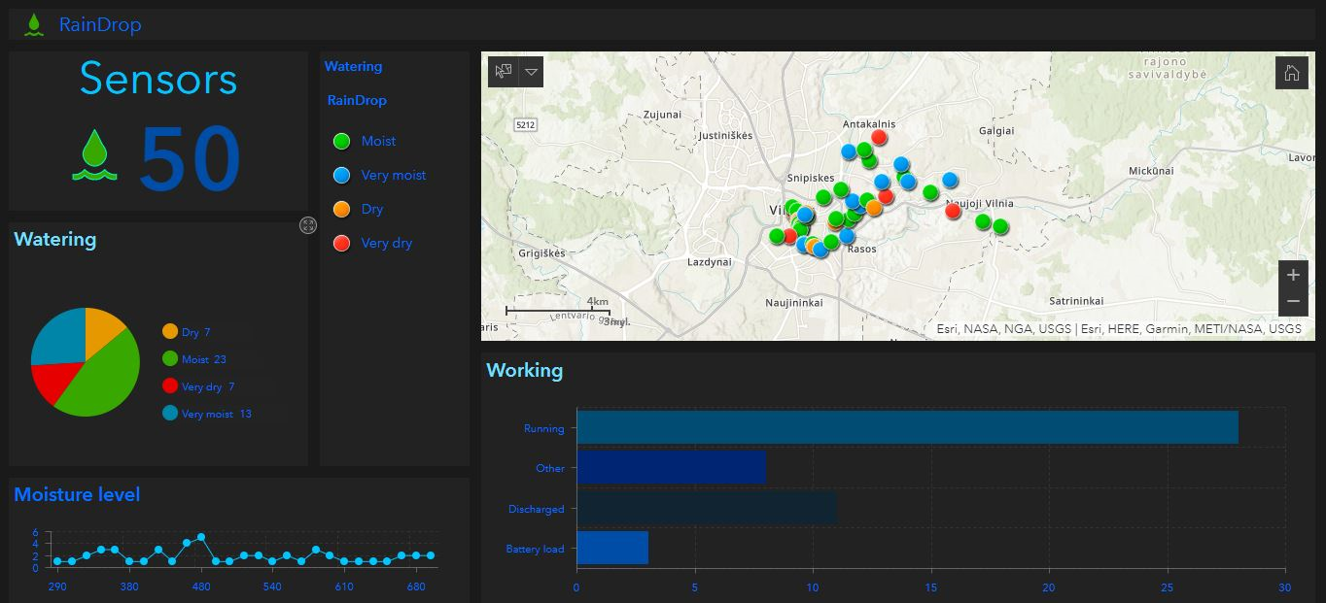
Sensors in Vilnius city

